Slide 1
IFB299 – Final Presentation
Jessica Cockett n8625573
Phyllis Yaw n9395130
Hudson Kennan n9652752
Connor Nicholls n9480412

Slide 2
System Architecture
Red House Real Estate
Front-end
MySQL server
Siteground Hosting
phpMyAdmin
Backend
HTML5
PHP
CSS3
JavaScript

Slide 3
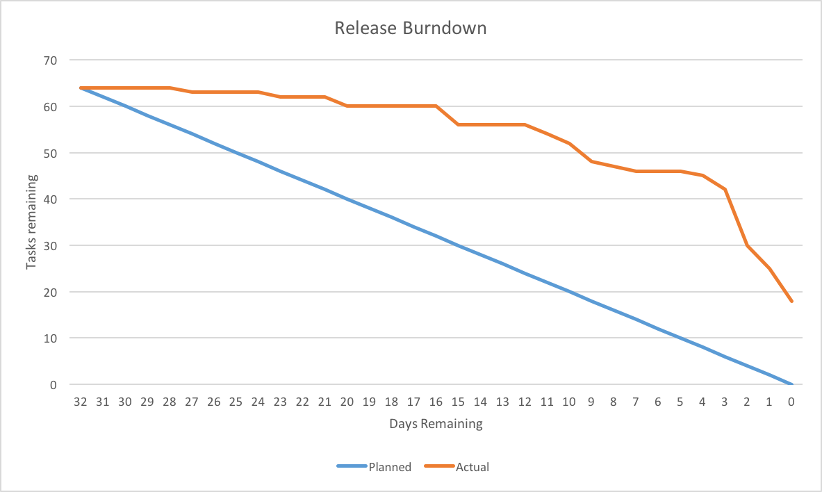
Burndown Chart

Slide 4
Sprint 1 User Stories
Catch-up from the first sprint, completed and in-progress

Slide 5
Sprint 1
Story ID | Complete | Incomplete | In-Progress
20 | ✔
12 | ✔
11 | ✔
08 |  |  | ✔
16 |  |  | ✔
10 | ✔

Slide 6
Story ID 20
Property Information
Priority
M
SP: 1
As a owner I want all property details listed so that details about my property can be found and rented out faster.
Acceptance Criteria
Property pages will have an Address, Number of Rooms, Furnished/Unfurnished, Availability, etc. and who the staff member taking care of the property is.
Property images on display (scrollable)
Each property page is generated from PHP script, queries the property database and not a static page
Property ID viewable on the page and in the URL
Notes
Available information and layout consistent across all properties
Owners can also edit property info while viewing

Slide 7
Story ID 12
Property Search
Priority
M
SP: 4
As a potential client, I want to be able to search available properties by ID, suburb, weekly rent, property type, and furnishings so that I can more easily find a property suiting my needs, or locate a property I saw advertised on Gumtree
Acceptance Criteria
Properties can be searched using the filters of ID, suburb, min/max weekly rent, property type, and whether it’s furnished or unfurnished
Properties database to hold all property information that can be queried
Notes
Suburb and property type options in a dropdown menu, ID, min/max rent using input forms, furnished or unfurnished using a checkbox
Search bar along the top of the search page/search results
Search results generated on the same page
Primarily PHP pages generated

Slide 8
Story ID 11
User Registration
Priority
M
SP: 2
As a potential tenant I want to be able to register so that I can book property inspections.
Acceptance Criteria
Registration option along the top of the web page
Prompt and link to register should an unregistered user attempt to make a booking for an inspection
Upon registration, client’s data is entered into the database
Registration requires basic tenant information only
Notes
Requires tenant database
Notes:
Should creation of databases/website back-end be a separate user story? Would probably be a Must Have, maybe a 2

Slide 9
Story ID 08
Contact Information Page
M
SP: 1
As a potential customer (tenant or owner) I want to be able to make enquiries so that my questions will be answered.
Acceptance Criteria
Contact form available on the website with fields where details regarding the enquiry can be filled
Submission of enquiry converts the enquiry into an email which goes to a relevant staff member
Notes
Found in the contact us page, which is linked from most web pages viewable to the public, as well as the navigation bar
Enquiries should be answered in a timely manner

Slide 10
Story ID 16
Customer Enquiries
Priority
M
SP: 1
As a user of the website I want to be able to contact agents so that I can organise inspections, enquire and ask general questions.
Acceptance Criteria
Contact Us page linked from most other areas of the website
Contact Us page has an enquiry form
Notes
Contact us forms will email the necessary person.
For users that haven’t registered yet

Slide 11
Story ID 20
Property Information
Priority
M
SP: 1
As a owner I want all property details listed so that details about my property can be found and rented out faster.
Acceptance Criteria
Property pages will have an Address, Number of Rooms, Furnished/Unfurnished, Availability, etc. and who the staff member taking care of the property is.
Property images on display (scrollable)
Each property page is generated from PHP script, queries the property database and not a static page
Property ID viewable on the page and in the URL
Notes
Available information and layout consistent across all properties
Owners can also edit property info while viewing

Slide 12
Sprint 2 User Stories
In-progress and completed

Slide 13
Sprint 2
Story ID | Complete | Incomplete | In-Progress
03 | ✔
07 |  |  | ✔
18 | ✔
02 | ✔
05 | ✔
04 |  |  | ✔

Slide 14
Story ID 03
Property Management
M
SP: 1
As a owner I want access to my property information and details so that I can make changes and update details, images, etc.
Acceptance Criteria
Edit option for properties shown to owners when logged in and viewing property
Ability to add/delete/edit photos and information for property
Edit property option available when viewing properties from account page
Notes
Requires owner to have an account (assumed automatically made upon acceptance of property)
Account details would be saved to owner database
Modifications made to property database

Slide 15
Story ID 07
Administrative control
M
SP: 1
As a business owner (David) I want to be able to have administrative control so that I can add, change or delete property details, in addition to staff abilities.
Acceptance Criteria
Members of staff and owners limited to certain privileges
David assigned an admin account with special privileges (staff + owner privileges), as well as some other abilities such as access to the database, ability to make changes to the site, etc.
Notes
Privileges assigned to account types through David’s personal account

Slide 16
Story ID 18
Property Display Page
M
SP: 4
As a potential tenant I want the website to provide the property details on the page so that I know more information about the property I’m looking at and can determine if it’s right for me.
Acceptance Criteria
Property pages will have an Address (may or may not be shown depending on owner’s preferences), Number of Rooms, Bathrooms etc., Availability and who the staff member taking care of the property is.
Property images on display (scrollable)
Each property page is generated from PHP script, queries the property database and not a static page
Property ID viewable on the page and in the URL
Notes
Requires property database
Uses the property ID for page URL

Slide 17
Story ID 02
Customer ID
M
SP: 1
As a staff member I want tenants to have an ID so that they are easier to identify and keep track of
Acceptance Criteria
Implementation of tenant ID in the database
Enquiries/contact through emails identified with a tenant ID
Tenants assigned a unique ID
Notes
Tenant ID found in database for tenants and properties
Requires tenant database, also connected to property database to help identify which properties are linked with which tenants

Slide 18
Story ID 05
Personal Account Editor
M
SP: 1
As a member of staff I want to be able to see and add/delete/update my details so I can keep things up to date.
Acceptance Criteria
Allows for basic changes to account information through website such as contact info. Other information such as applying for a change in bank details or rostering, as well as leave applications required to be completed on a paper form and submitted
Each staff member assigned a unique ID, able to be differentiated from that of owners and tenants (e.g. how QUT uses n for students and s for staff)
Each staff member given an account upon beginning employment
Notes
All information would be verified then updated and saved to staff database
Requires staff database
Assuming staff accounts created by David once employment confirmed

Slide 19
Story ID 04
Inspection/Scheduling Management
M
SP: 2
As a member of staff I want to be able to manage my properties so that I can set inspection times, scheduling and see my assigned properties.
Acceptance Criteria
Full inspections and schedules viewable on the scheduling page
Staff can have a quick overview of information, properties assigned to them, inspections and scheduling, etc. for each property from their primary account page
New and upcoming inspection times and scheduling present as notifications linking to scheduling page
Notes
Each property assigned to the particular staff member has a name and contact information of the property owner, or owner ID
Staff members can’t change property information.
Requires database to store scheduling information, etc.
Requires staff database

Slide 20
Design
Prototype
Final Website
Used Google Sites
Easy to use and work towards on a final product
Wire framing multiple pages
Hosted
Using
PHP
MySQL
CSS3
JavaScript
HTML5

Slide 21
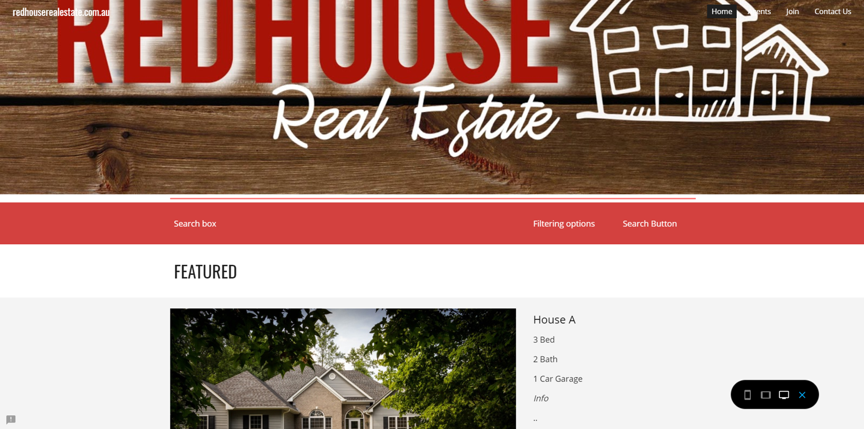

Slide 22
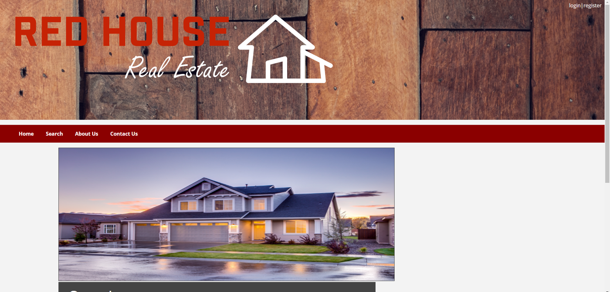

Slide 23
